Slide 1

Sudoku Array Optimization
CMPS-4143-101 Cont. Lang.
Daniel Portillo & Sarah Turner

Slide 2
Introduction
Our Proposal: We can create an algorithm that can optimize a Rule Based Algorithm used to solve a Sudoku puzzle using a single dimensional array.
Our : We have successfully created an array based Algorithm that is somewhat comparable (yet still inferior) to the efficiency of the original problem as a java file. As well as a .txt test case file for the program as input. In addition, the file also fills another .txt file with the times that each puzzle takes to solve as output.
Notes:
Introduction
•
What you (as a group) have proposed
Is something faster , etc.
•
Mention all proposed items
•
What you (as a group) have done
•
Mention all finished items
Did do the one array thing

Slide 3
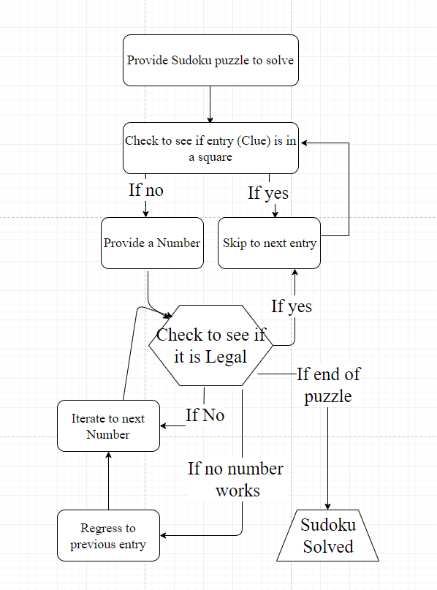
Our Approach
Flowchart
We implemented A Rules Based Algorithm (RBA) on a single array in our code. We did this to see if one array would optimize the speed of solving Sudoku puzzles.
To compare speed we are using the timing of ‘A Study of Sudoku Solving Algorithms’ RBA, which is average time 0.2 seconds per puzzle in a sample size of 49151 17-clue puzzles.
For extra technology, we used a spreadsheets program to analyze our data to draw our conclusions from.

Slide 4
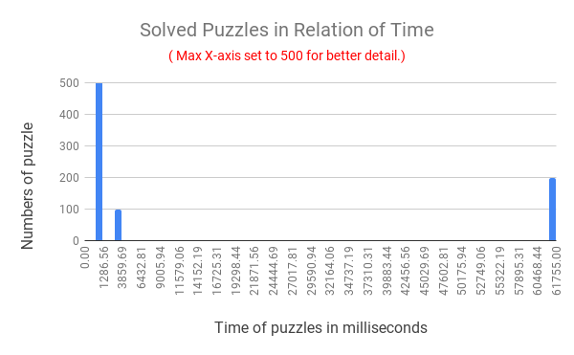
Chart Analyzation
We ran our algorithm though a sample size 50000. ( As it was easier to generate and close enough to the study )
99% of the Sudoku puzzles were solved equal to or less than 1 second. However, due to how our algorithm worked, some puzzles took much longer to solve.( More than a minute )
This may be due to the clues being in such a way that the algorithm will ‘solve’ most of the puzzles before deciding it cannot be done and thus returning to a previous point before attempting again with a different number. This can happen multiple times in one puzzle.
Large Discrepancy
Link to Chart

Slide 5
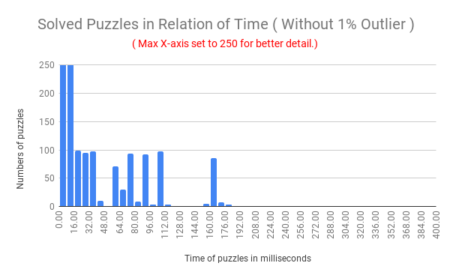
Chart Analyzation cout.
To better show the difference in timing we took out 1% ( 500 ) of the outliers.
48,399 puzzles are solved in between
0 - 8 milliseconds while the rest are between 8 - 180 milliseconds.
In total it took 2 hours to process.
Link to Chart

Slide 6
Is it Better?
While not better, our average time for all 50000 puzzles came out to 0.257 seconds.
This was run on a different system, this is still comparable to ‘A Study of Sudoku Solving Algorithms’ 0.2 seconds
Our time complexity on the other hand came out to be the same as theirs at about O(n²).

Slide 7
Challenges
Future Direction
Some difficulty in implementing the UI for our code
Figuring out the base logic for the validation of entries
Further optimization, perhaps having a time limit on puzzles before attempting to solve an inverted version of them to get around situations in which multiple recursive calls are made due to the placement of clues or by some other manner.
Notes:
Challenges, Conclusion, FutureDirection
•
What challenges have you faced during working this project]
code hard :( java sucks
•
Conclusion of your project
Idk haven got there yet lol
•
What can be done as a basis of your work; future direction not do java

Slide 8
Contributions of Daniel Portillo
Proposal:
Implement Possible Values Matrix
Validating Code and Algorithm solutions
Timing the Solutions
Formatting the output File
Contributions:
Developed and implementing the Rule Based Algorithm
Developed the Validation of entries and transversal of arrays
Developed the UI
Estimated the Time Complexity

Slide 9
Contributions of Sarah Turner
Contributions:
Made the Sudoku Test Cases
Read the test cases and timed them
Analyzed the data and visualize it.
Proposal:
Making the Sudoku test cases
Reading in the test cases into the 81 element array
Implementing the Rule based algorithm

Slide 10
Q&A

